Slide 1
Similarity-based Music Video Retrieval
Machine Learning for Multimodal Data
Georgios Batsis

Slide 2
Problem Statement
Information Retrieval Systems: Necessity of information filtering due to the rapid increase of multimedia data on digital platforms.
Most important application of IR systems → Recommender Systems
Music Video Retrieval:
Complex problem due to the combination of two modalities: music and video.
Combination of methods from Music Information Retrieval and Video Retrieval tasks.
Goal: Capture content-based information from both modalities.

Slide 3
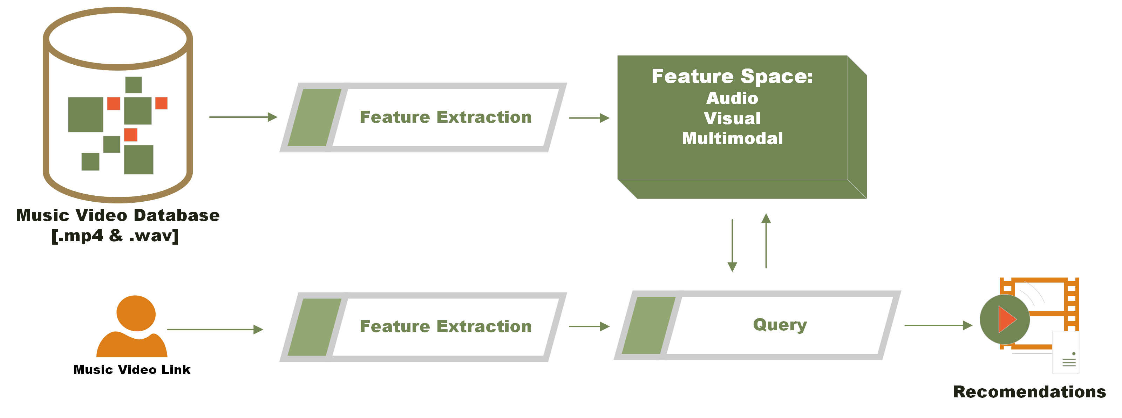
Overview

Slide 4
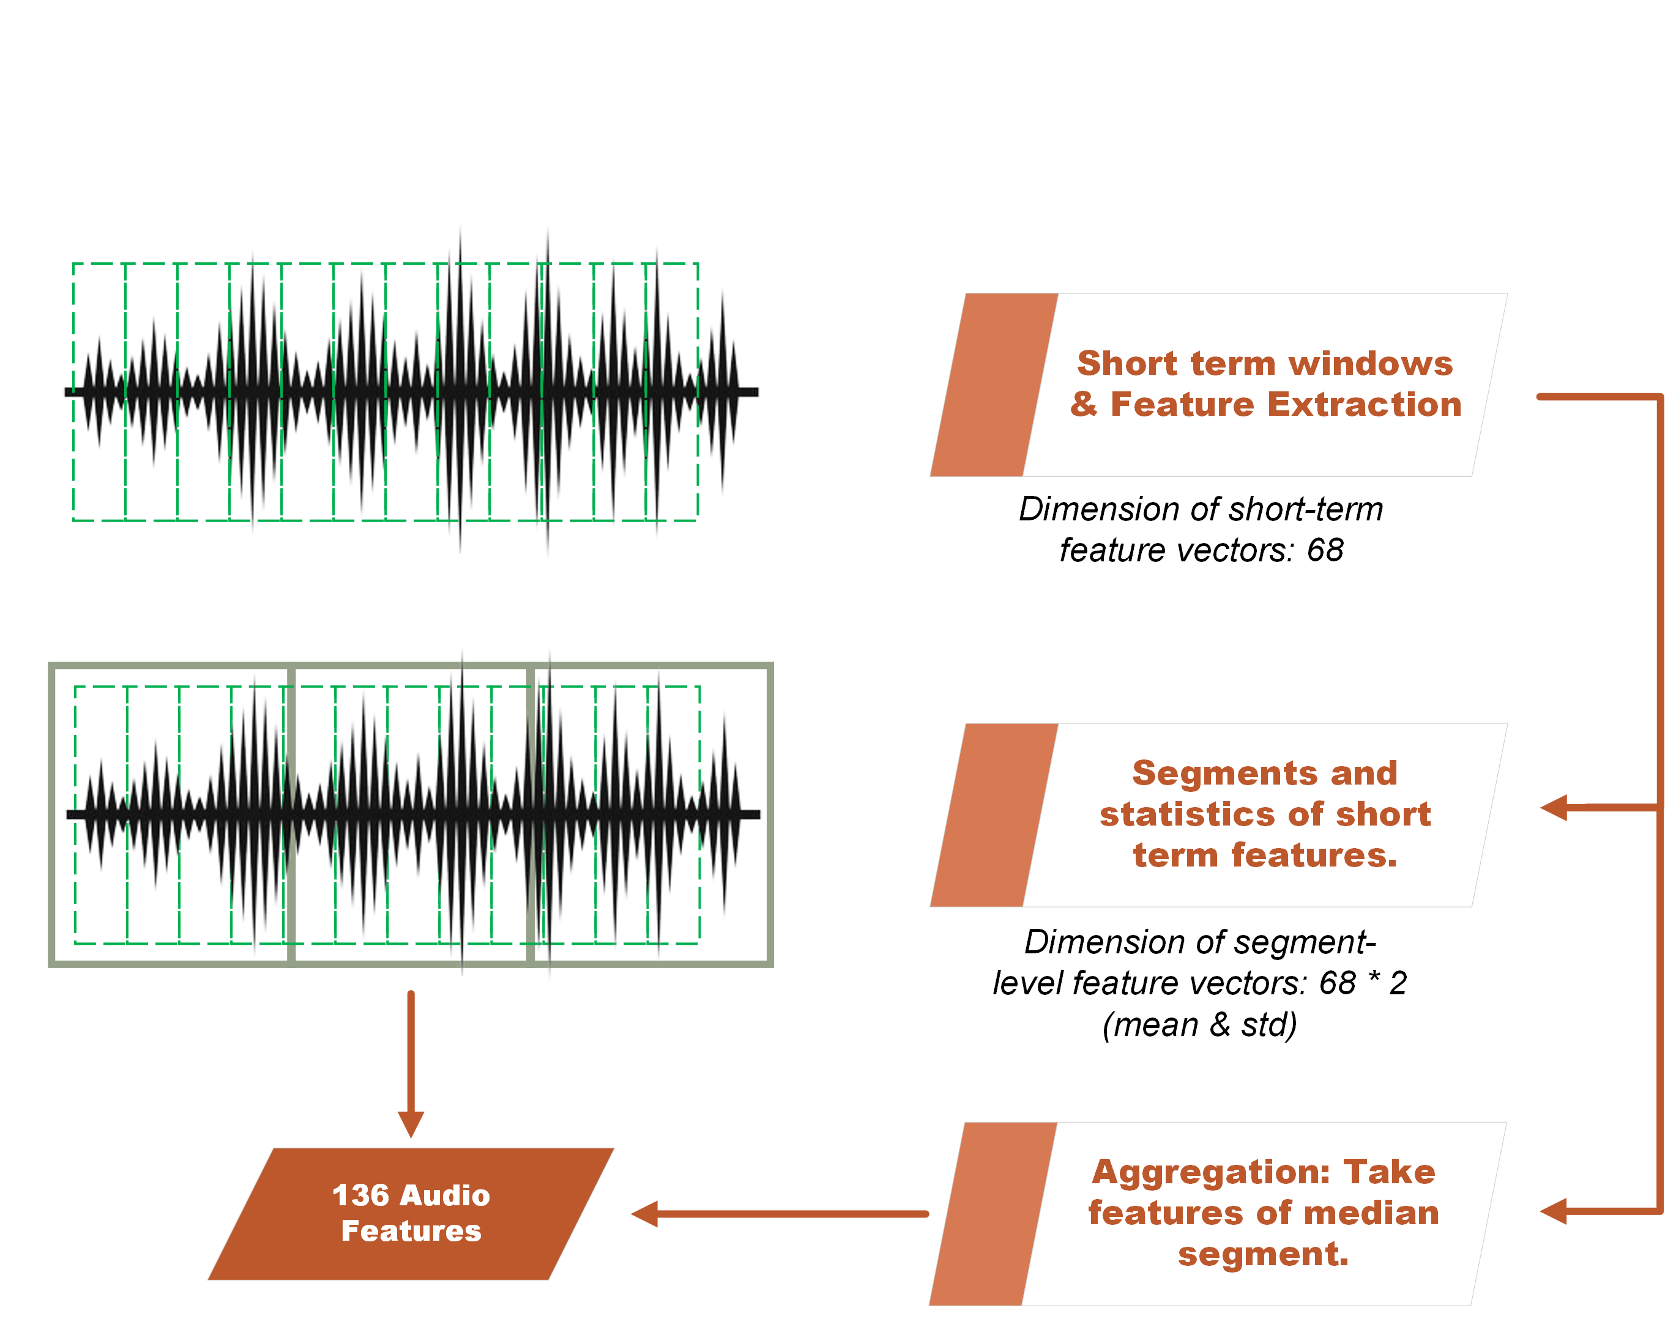
Feature Extraction: Audio
Zero crossing rate
Energy
Entropy of energy
Spectral centroid
Spectral spread
Spectral entropy
Spectral flux
Spectral rolloff
Mel Frequency
Cepstral Coefficients
(13 features)
Chroma vector
(12 features)
Chroma deviation

Slide 5
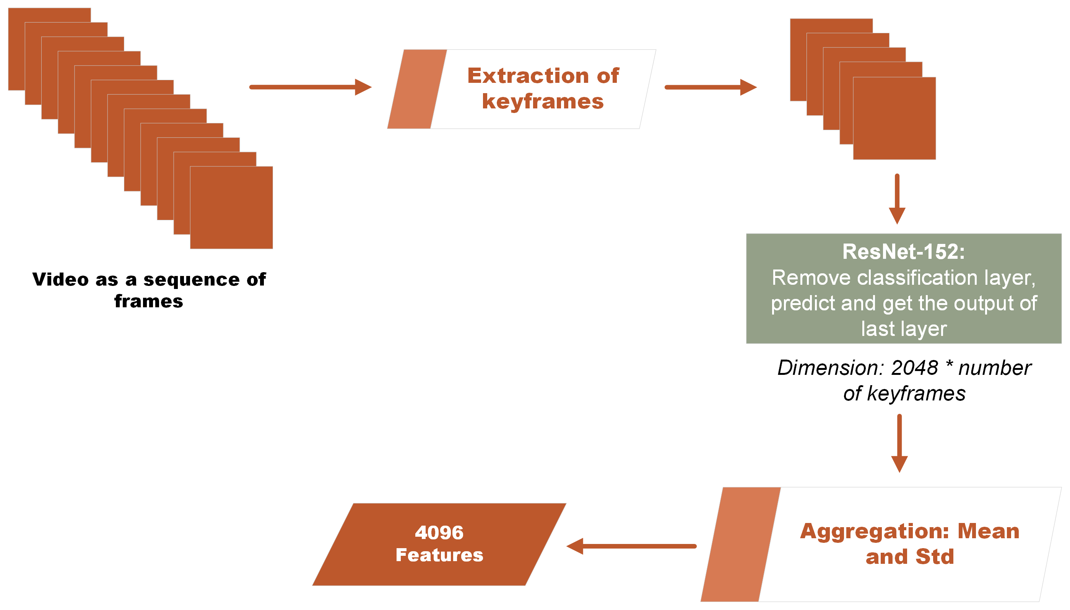
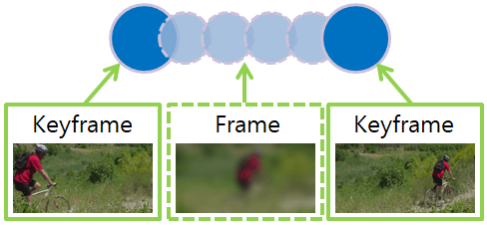
Feature Extraction: Video

Slide 6
Retrieval Process
Feature Spaces:
Audio
Visual
Fused [Dimensions: 136 + 2*2048 = 4234]

Slide 7
Retrieval Process
Feature Spaces:
Audio
Visual
Fused [Dimensions: 136 + 2*2048 = 4234]
User Query:
1) Feature extraction according to the modality option
2) Database searching:
Try to find the most similar features using a similarity/distance metric
Which metric?
Euclidean
Cityblock
Cosine
Correlation
Hamming
Jaccard
Jensenshannon
Chebyshev
Canberra
Bray-Curtis
Sokalsneath

Slide 8
Retrieval Process
Feature Spaces:
Audio
Visual
Fused [Dimensions: 136 + 2*2048 = 4234]
User Query:
1) Feature extraction according to the modality option
2) Database searching:
Try to find the most similar features using a similarity/distance metric
Which metric?
Small subset of Music Videos:
Metric Selection
Validation of system functionality
Use validation Music Videos to identify the number of correct recommendations:
Correct recommendation = Belongs to the same music genre as the video query.
Euclidean
Cityblock
Cosine
Correlation
Hamming
Jaccard
Jensenshannon
Chebyshev
Canberra
Bray-Curtis
Sokalsneath

Slide 9
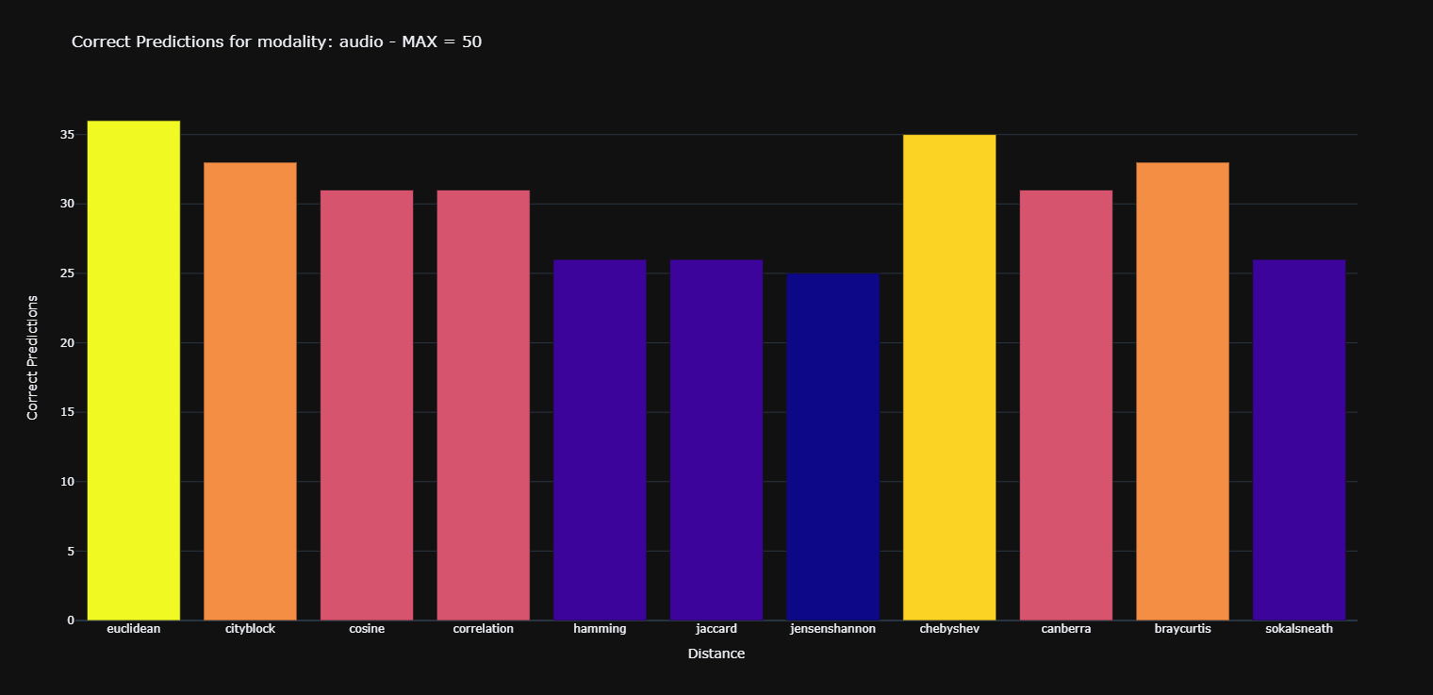
Results – Modality: Audio

Slide 10
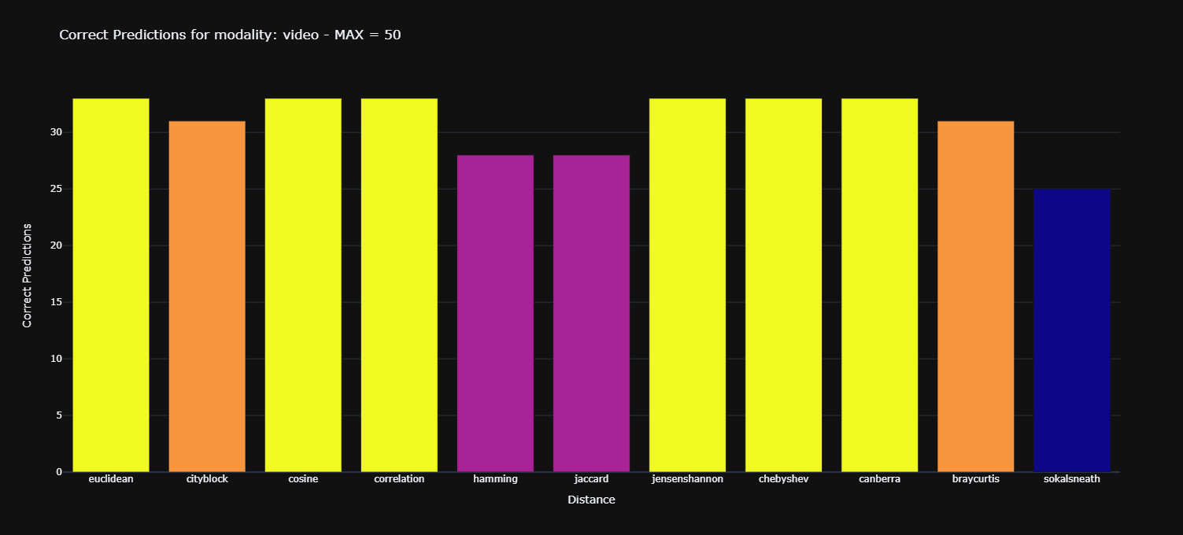
Results – Modality: Video

Slide 11
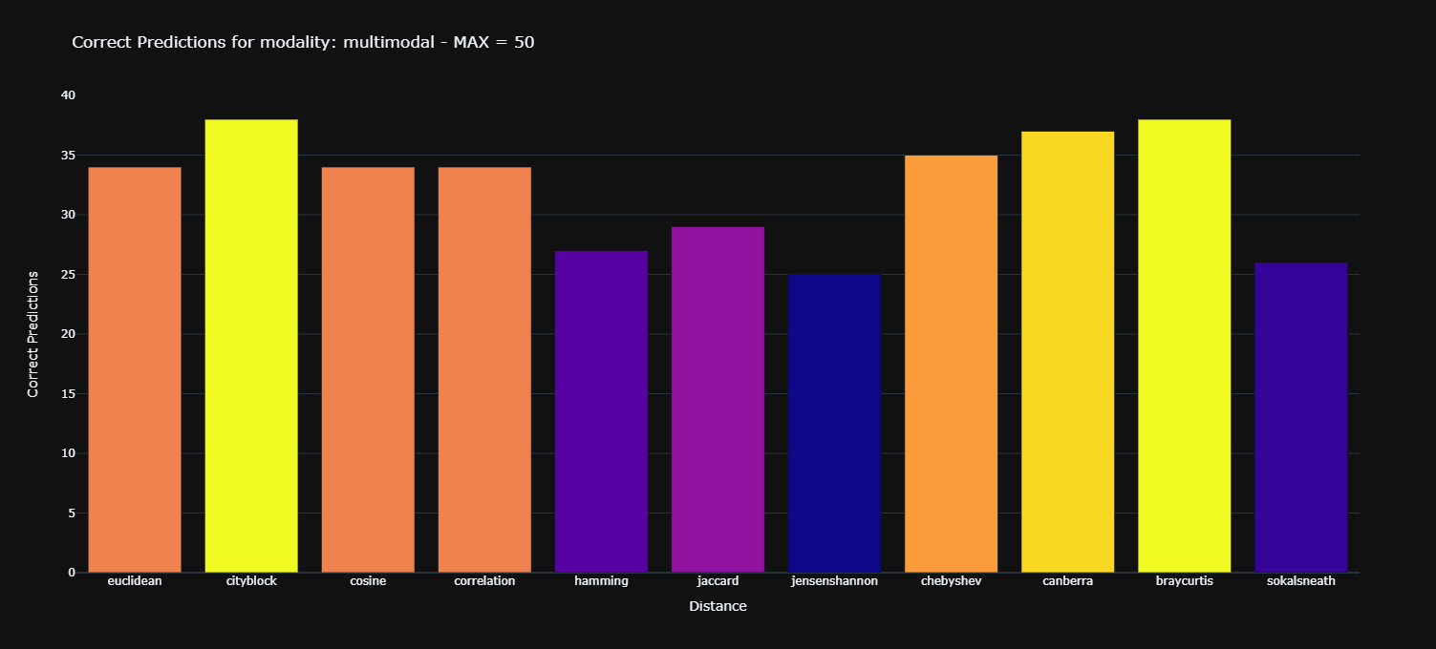
Results – Multimodal

Slide 12
Demo

